Slide 1
EMS702UP Statistical Thinking and Applied Machine Learning
W5.3 Fuzzy Rule Based System as a Controller and Design Choice
Jun Chen

Slide 2
Fuzzy Rule Based Systems as a Fuzzy Controller
Rule Based control was used before Mamdani’s controller. What makes fuzzy logic control so innovative lies in the way all those rules were processed. We need fuzzy control as
It differs significantly from conventional control.
It does not use mathematical models of the process under investigation.
It can comprehend instructions and generate strategies based on verbal communication.
Control engineers can relate to it better than they would do with conventional methods.
The above does not imply that people have been applying the wrong numeric model. They have been using mathematical models which can describe “at best” the process under investigation. However, systems/processes can be characterised by
Uncertainty
Non-linearities
Unmodelled dynamics
In this case, mathematical models will be ineffective.

Slide 3
Fuzzy Rule Based Systems as a Fuzzy Controller
Fuzzy logic control came at a crucial time where dissatisfaction with conventional control was growing. Fuzzy Logic Control can be said to
Be able to translate imprecise/vague knowledge of human experts.
Be simple and easy to implement.
Be fully supported by software design and hardware implementation.
Be able to generate smooth control.
Be able to produce robust control behaviour.
Be able to solve the curse of dimensionality.
Be able to control unstable systems.

Slide 4
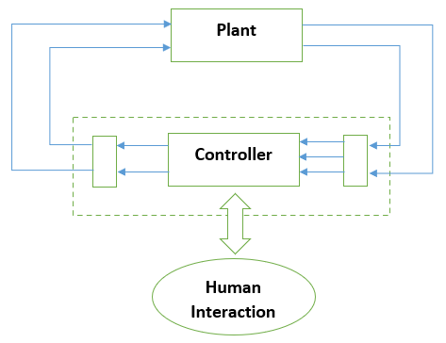
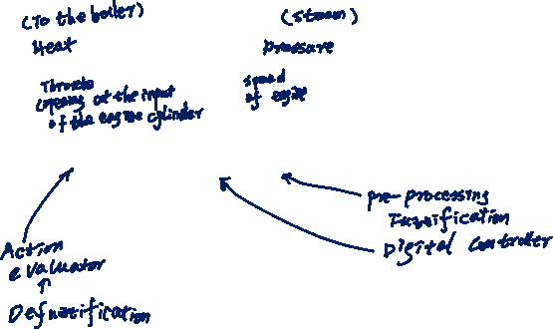
Fuzzy Rule Based Systems as a Fuzzy Controller
E. H. Mamdani constructed the first fuzzy controller (see below) to control a plant comprising a steam-engine and boiler combinations.
Highly non-linearity
Presence of time-delay

Slide 5
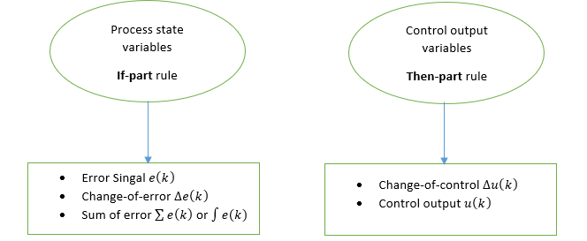
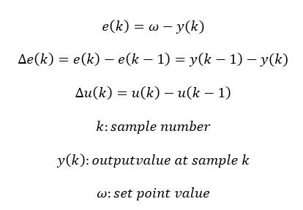
Fuzzy Rule Based Systems as a Fuzzy Controller
In order to design a PID-like fuzzy controller, it is necessary to choose the input-output variables and the rules of the controller properly. If a decision has already been made to design a P-, PD-, PI- or PID-like controller, it implies automatically a choice of the process state(s) and control output variables as well as the content of the rule-antecedent and the rule-consequent parts of each rule.

Slide 6
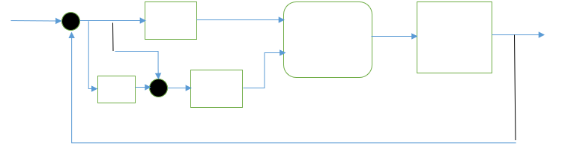
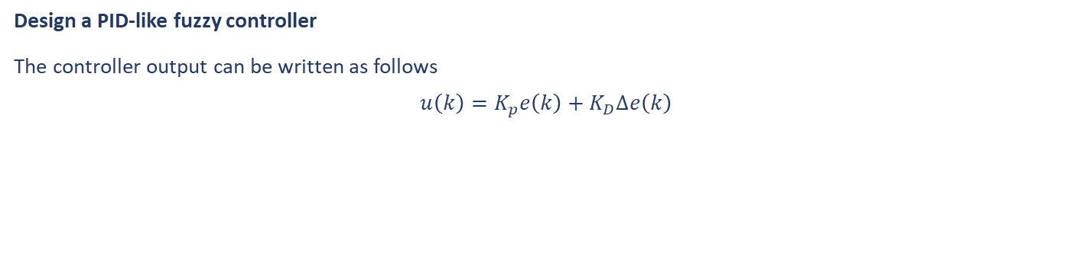
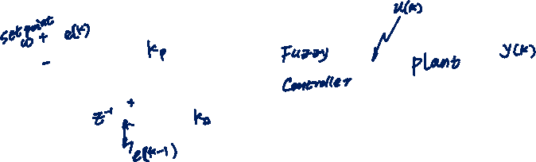
Fuzzy Rule Based Systems as a Fuzzy Controller
Design a PID-like fuzzy controller
The controller output can be written as follows
$$u\left(k\right)=K_{p}e\left(k\right)+K_{D}∆e\left(k\right)$$
Where $K_{p}$ and $K_{D}$ are the proportional and derivative relating to the controller

Slide 7
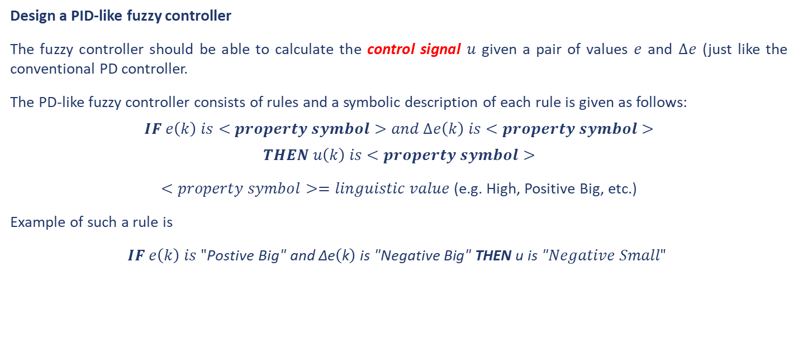
Fuzzy Rule Based Systems as a Fuzzy Controller
Design a PID-like fuzzy controller
The fuzzy controller should be able to calculate the control signal $u$ given a pair of values $e$ and $∆e$ (just like the conventional PD controller.
The PD-like fuzzy controller consists of rules and a symbolic description of each rule is given as follows:
$$IF e\left(k\right) is<property symbol>and ∆e\left(k\right) is<property symbol>$$
$$THEN u\left(k\right) is<property symbol>$$
$<property symbol>=linguistic value$ (e.g. High, Positive Big, etc.)
Example of such a rule is
$IF e\left(k\right) is "\text{Postive} \text{Big}\text{" }\text{and}\text{ ∆}\text{e}\left(\text{k}\right) \text{is}\text{ "}\text{Negative} \text{Big}\text{" }\text{THEN} \text{u} \text{is}\text{ "}Negative Small"$

Slide 8
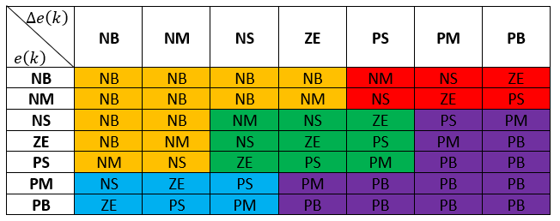
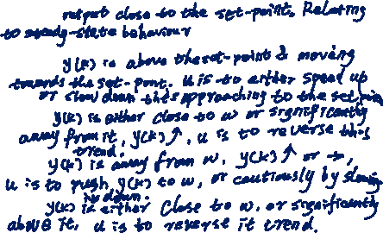
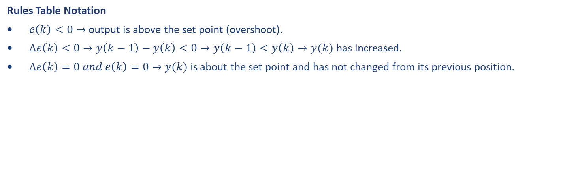
Fuzzy Rule Based Systems as a Fuzzy Controller
Rules Table Notation
$e\left(k\right)<0→$ output is above the set point (overshoot).
$∆e\left(k\right)<0→y\left(k−1\right)−y\left(k\right)<0→y\left(k−1\right)<y\left(k\right)→y(k)$ has increased.
$∆e\left(k\right)=0 and e\left(k\right)=0→y(k)$ is about the set point and has not changed from its previous position.
Group 1:
Group 2:
Group 3:
Group 4:
Group 5:

Slide 9

Fuzzy Rule Based Systems as a Fuzzy Controller
Example 8
Do all PD-like fuzzy controllers have the same configuration as that of the above table?
Solution

Slide 10
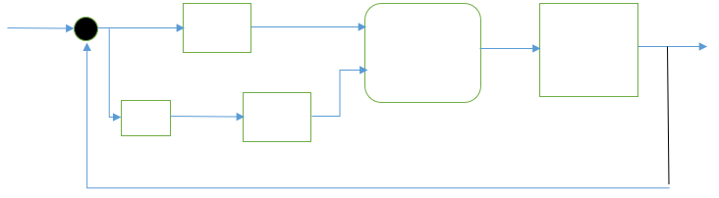

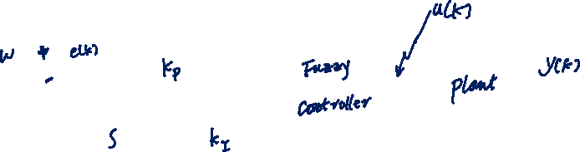
Fuzzy Rule Based Systems as a Fuzzy Controller
Design a PI-like fuzzy controller
The controller output can be written as follows
$$u\left(t\right)=K_{p}e\left(t\right)+K_{I}\int{e\left(t\right)}dt$$
Where $K_{p}$ and $K_{I}$ are the proportional and integral relating to the controller
Note: formulating rules according to error and sum-of-error (or integral of error) can prove to be a difficult exercise, because we will inevitably generate a relatively large universe of discourse for sum-of-error.

Slide 11
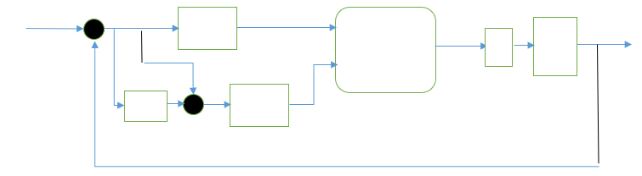
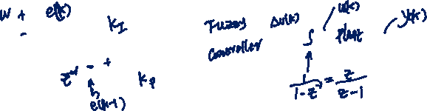

Fuzzy Rule Based Systems as a Fuzzy Controller
Design a PI-like fuzzy controller
To solve this problem, let us change the above equation into the following:
$$\frac{du\left(t\right)}{dt}=K_{p}\frac{de\left(t\right)}{dt}+K_{I}e(t)$$
Hence,
$$∆u\left(k\right)=u\left(k\right)−u\left(k−1\right)=K_{p}∆e\left(k\right)+K_{I}e\left(k\right)$$
$$u\left(k\right)={u\left(k−1\right)+K}_{p}∆e\left(k\right)+K_{I}e\left(k\right)$$
The controller gives a change of control action rather than the control action itself.

Slide 12
Fuzzy Rule Based Systems as a Fuzzy Controller
Design a PI-like fuzzy controller
As far as the rules are concerned, the rules table for the PD-like controller can still be used but the controller gives change-of-control.
The PI-like fuzzy controller consists of rules and a symbolic description of each rule is given as follows:
$$IF e\left(k\right) is<property symbol>and ∆e\left(k\right) is<property symbol>$$

Slide 13
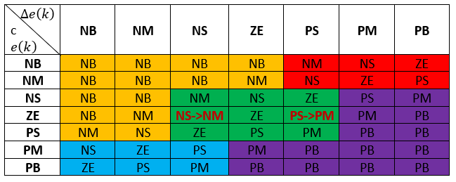
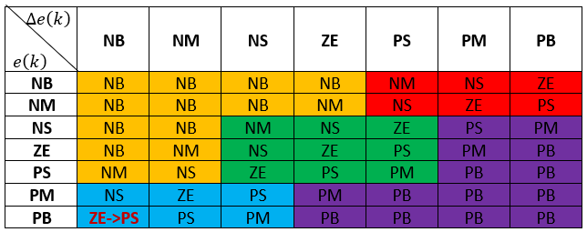

Fuzzy Rule Based Systems as a Fuzzy Controller
Example 9
Consider the following minors changes made to the table in Section 3.2, what will be the implications of such changes?
Solution
Note: One should not always use error and change-of-error. Instead, the states of the system can be introduced in the rule specification process.

Slide 14
Fuzzy Rule Based Systems Parameter Choice
A fuzzy rule based system design process includes the same steps as any other design process, i.e.,
Initial choice of structure and parameters.
Subsequent adjustment based on the analysis.
The first step possesses a high degree of subjectivity.
As a result, this step will require a high effort in order to be effectively implemented.
Hence, the better the initial choice is, the simpler the second step will be.

Slide 15
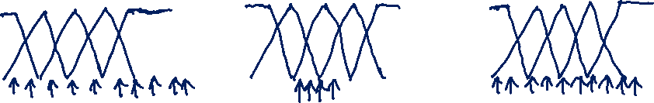
Fuzzy Rule Based Systems Parameter Choice
Scaling Factors Choice
A fuzzy rule based system includes fuzzification and defuzzification. The membership functions which describes the different values of the linguistic variables are applied during both stages (fuzzification and defuzzification). In the choice of membership functions, the definition universe of discourse is of prime importance.
We can identify two major problems:
The range covered by the universe of discourse is too small
The range covered by the universe of discourse is too large
The correct choice would cover the whole range without going over

Slide 16
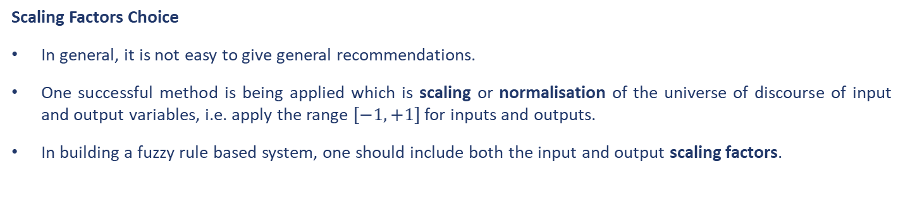
Fuzzy Rule Based Systems Parameter Choice
Scaling Factors Choice
In general, it is not easy to give general recommendations.
One successful method is being applied which is scaling or normalisation of the universe of discourse of input and output variables, i.e. apply the range $[−1, +1]$ for inputs and outputs.
In building a fuzzy rule based system, one should include both the input and output scaling factors.
As far as tuning the fuzzy controller is concerned, let us assign a few priorities:
The output scaling factor has the most influence on stability and oscillation tendency – Priority 1
The input scaling factors have the most influence on the basic sensitivity of the controller – Priority 2
The shape and location of the input and output membership functions may influence the behaviour of the controlled system in different areas of the state space – Priority 3

Slide 17
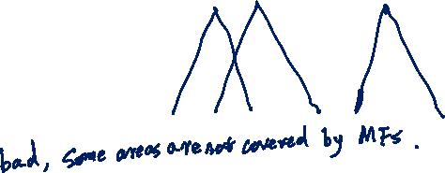
Fuzzy Rule Based Systems Parameter Choice
Membership Function Choice
In the membership function choice, one has to consider the following parameters:
The number of classes
The position of the various membership functions
The width of the membership function
The peak of the membership function
The shape of the membership function
Example 10
Let us consider the membership functions in the plot to the right. Is this representation good or bad?
Solution

Slide 18
Fuzzy Rule Based Systems Parameter Choice
Fuzzy Rule Formulation
In relation to rule formulation one question can be asked – how do we find the rules practically?
Redeveloping, manuals, operation instructions, and any other documents available into a set of useful rules.
Interrogation of experienced experts using a carefully organised questionnaire.
Rules can also be formulated by observing how a skilful operator operates/controls the system/process.
There are other methods which are based on measured data, for instance:
Synthesis a set of rules based on the model of the system/process.
Using a learning mechanism that will derive/elicit the rules online or offline.

Slide 19
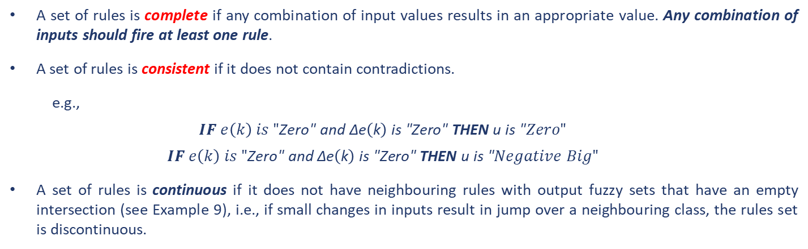
Fuzzy Rule Based Systems Parameter Choice
Fuzzy Rule Formulation
Usually, rules are formulated one by one; after this one has to analysis the whole set of rules. In this analysis, one needs to determine if the set of rules is complete, consistent and continuous.
A set of rules is complete if any combination of input values results in an appropriate value. Any combination of inputs should fire at least one rule.
A set of rules is consistent if it does not contain contradictions.
e.g.,
$$IF e\left(k\right) is "\text{Zero}\text{" }\text{and}\text{ ∆}\text{e}\left(\text{k}\right) \text{is}\text{ "}\text{Zero}\text{" }\text{THEN} \text{u} \text{is}\text{ "}Zero"$$
$$IF e\left(k\right) is "\text{Zero}\text{" }\text{and}\text{ ∆}\text{e}\left(\text{k}\right) \text{is}\text{ "}\text{Zero}\text{" }\text{THEN} \text{u} \text{is}\text{ "}Negative Big"$$
A set of rules is continuous if it does not have neighbouring rules with output fuzzy sets that have an empty intersection (see Example 9), i.e., if small changes in inputs result in jump over a neighbouring class, the rules set is discontinuous.
One rule must be excluded!!

Slide 20
Fuzzy Rule Based Systems Parameter Choice
Choice of the Defuzzification Procedure
Defuzzification is essential in Mamdani-type fuzzy rule based systems but is not required in Sugeno-type fuzzy rule based systems. There are more than 5 defuzzification methods, but only two received much attention:
Centre (centroid) of Area/Gravity method
Mean of Maxima method
None of them have proved to be more advantageous over one another. The criteria for comparison should be:
Continuity – whether a small change in the input generates a large change in the output.
Un-ambiguity – whether it works in any situation.
Plausibility – produces an output that lies approximately in the middle of the support of the resulting membership function and has a high degree of membership.
Computational complexity.

Slide 21
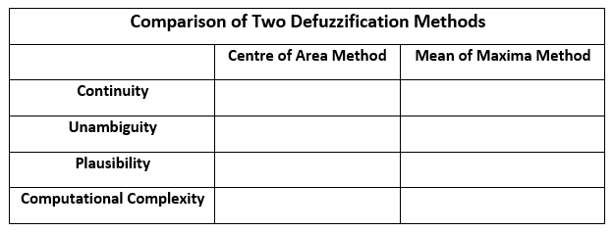

Fuzzy Rule Based Systems Parameter Choice
Choice of the Defuzzification Procedure
Example 11
The following table can be produced with reference to the two most popular defuzzification methods. Fill in the empty cells.
Solution

Slide 22
End slide

